Slide 1

SMART FARM APPLICATION USING IOT AND ML
Project Supervisor: Dr. A. Mary Posonia, M.E., Ph.D.,
Name of the Student: Mr. Rajeev Nayan
Register Number: 39110828

Slide 2
Presentation Outline
Introduction
Problem Statement
Objectives
System Architecture / Ideation Map
Project Implementation
Methodology
Application Snapshots
Results and Discussions
Conclusion
Future Research
References

Slide 3
Introduction
In India, agricultural in mainly dependent on monsoons which has insufficient source of water and there is also a lack of knowledge on the type of crop which can be grown in the particular type of Soil.
Nowadays, for irrigation, different techniques are available which are used to reduce the dependency of rain.
To overcome this issue, an automatic irrigation system and an application for predicting the best crop to be grown can be designed for increasing the crop yield.

Slide 4
Problem Statement
In the case of traditional irrigation system water saving is not considered , due to which a lot of amount of water is wasted and the crop to be grown is not known due to which the required crop yield is not achieved.
To overcome this problem, a system must be designed to overcome this issue.

Slide 5
Objectives
To design a system to automate the process of irrigation and to find the best crop to be grown in the particular type of Soil based on the nutrients present in the Soil , its pH and other factors.
It helps in providing automated water supply, reduces water wastage and also helps in finding the best crop that can be grown in the particular type of soil.
This goal can be achieved by designing a system to automate the process of irrigation using NodeMCU and various other sensors and using various Machine Learning Algorithms.

Slide 6
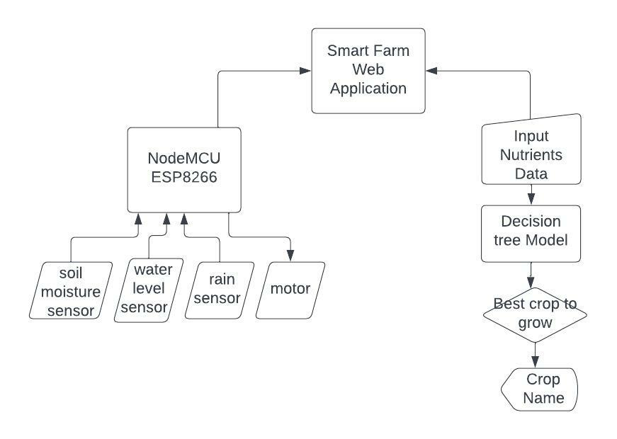
System Architecture / Ideation Map

Slide 7
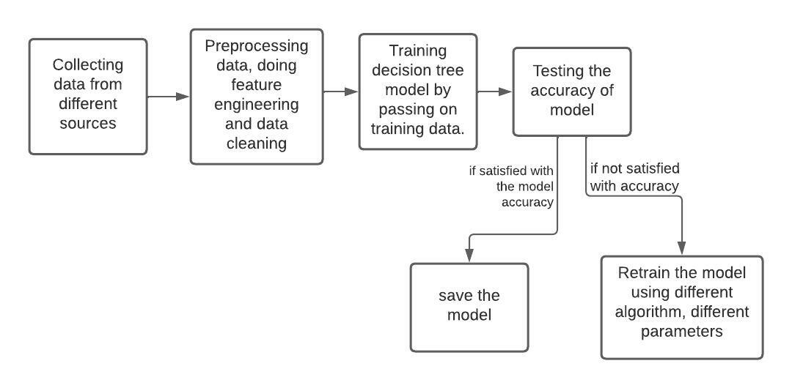
System Architecture / Ideation Map

Slide 8
Project Implementation
HARDWARE REQUIREMENTS – NodeMCU ESP8266, Soil Moisture Sensor, Rain Sensor, Float Sensor, Relay Module, DC 3-6V Submersible Water Pump, 9V Battery, Jumpers, Breadboard.
SOFTWARE REQUIREMENTS – Arduino IDE 1.8.16, VS Code, Python, Jupyter Notebook, HTML, CSS, Flask, Bootstrap, Heroku, Github.

Slide 9
Project Implementation (IOT)
First I have connected the various sensors to collect the data after which the data is processed using the NodeMCU board and the data is pushed into ThingSpeak website for Visualization.
Based on the collected data, it is decided whether to start the water pump or not and the data is Visualized on the ThinkSpeak Website.

Slide 10
Project Implementation (ML)
First the dataset is imported into the Juypter Notebook after which the data is cleaned and then it is preprocessed followed by data cleaning and then training using the decision tree model and finally testing the Accuracy of the model.
If the Model Accuracy is satisfactory, the model is saved , otherwise ,the model is retrained using different algorithms and different parameters.
After which the Model is hosted on the website for accessing.

Slide 11
Methodology (IOT)
The first step is to collect the data from various Sensors (Soil Moisture, Rain, Float Sensor).
The second step includes the processing of data received from various sensors and pushing the data on the ThinkSpeak Website for Visualization.
The third step helps in deciding whether to start the motor or not based on the various conditions given such as if soil is wet or dry, etc.

Slide 12
Methodology (ML)
The first step is to Collect the data from the dataset into the Juypter Notebook followed by data preprocessing, data cleaning and then training using the decision tree model and then finally testing the Accuracy of the model.
If the Model Accuracy is satisfactory, the model is saved , otherwise ,the model is trained again using different algorithms and different parameters.
After this a Website is designed to push the ML Model into the website for easier access.

Slide 13
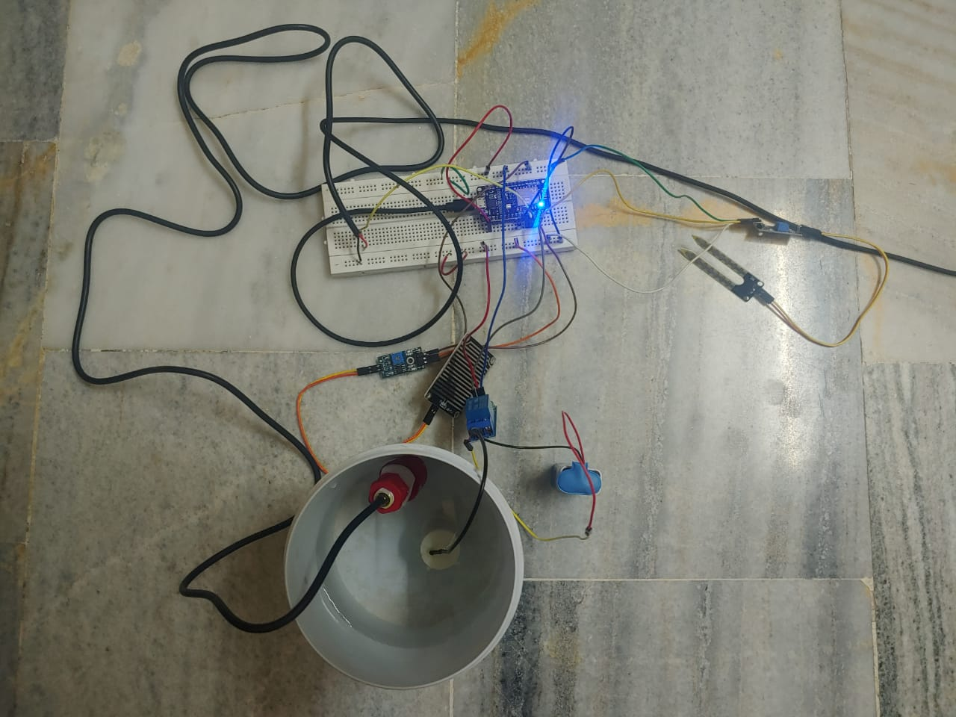
Application Snapshots

Slide 14
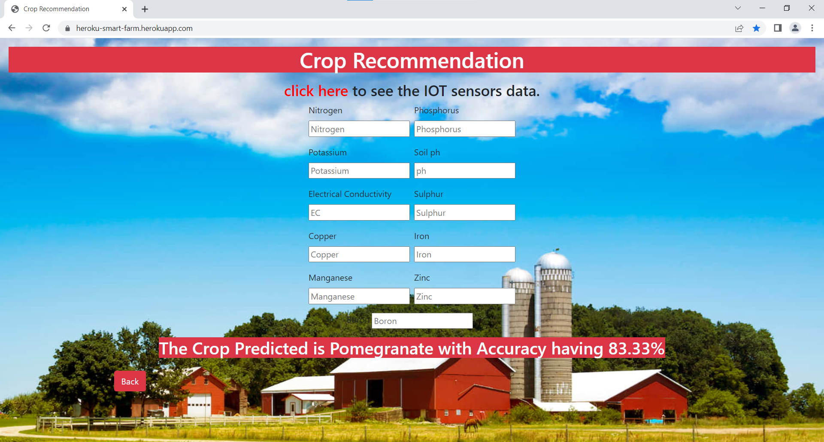
Application Snapshots

Slide 15
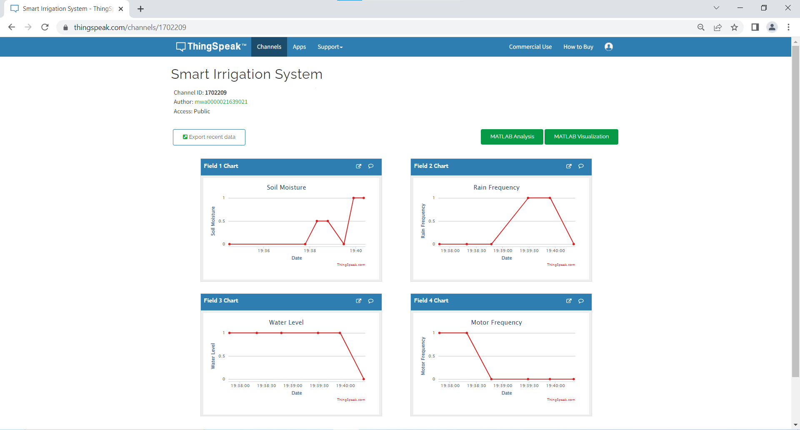
Application Snapshots

Slide 16
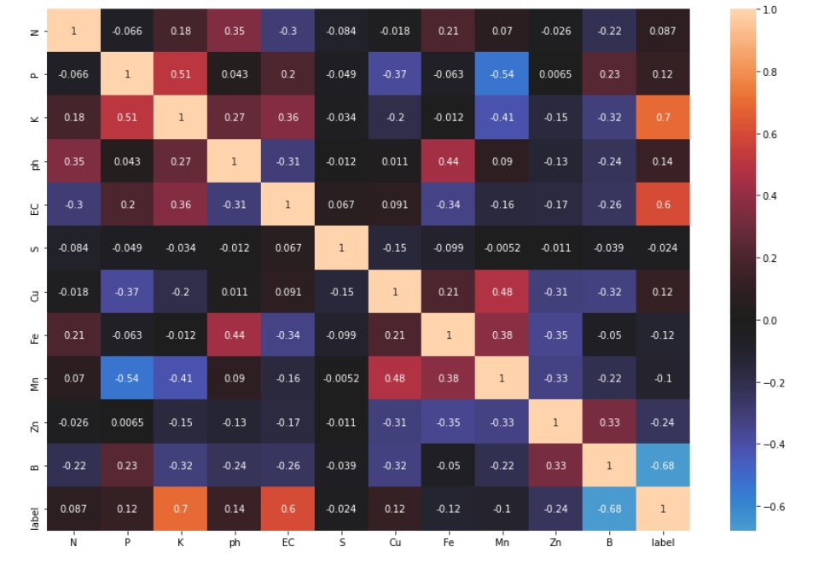
Correlation Matrix

Slide 17
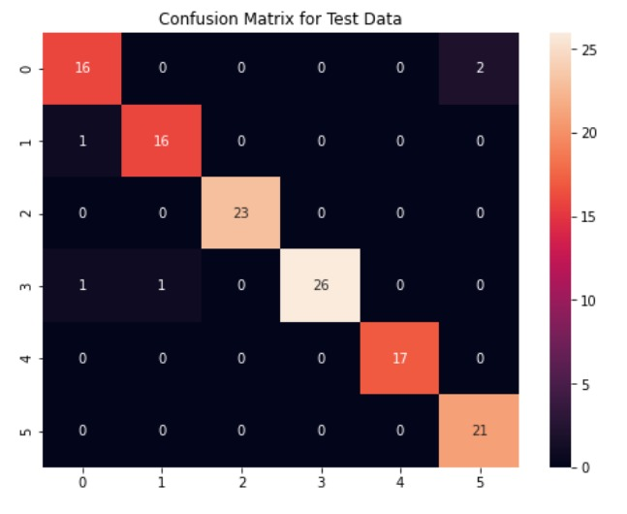
Confusion Matrix

Slide 18
Results and Discussion
The data received from the sensors is processed using the NodeMCU board and is pushed into the ThinkSpeak Website for Visualization based on the data processed it is decided whether to start the irrigation process or not.
The prediction process is carried out by training the dataset using the Decision Tree Algorithm.

Slide 19
Conclusion
This project helps in designing a system for automating the process of irrigation using NodeMCU board and various Sensors and for predicting the best crop that can be grown.
By implementing this system it helps in saving water, reducing labour and also in increasing food production.

Slide 20
Future Research
I have implemented this system only for one plant of a particular type and for a small area.
We can implement it for a large area and for a variety of plants by using a number of Soil Moisture Sensors and Solenoid Valves to start irrigation only for a particular area in a large farm and we can also train the model using more dataset for increasing the Accuracy.
Further we could also design a mobile application to control the System from anywhere.

Slide 21
References
[1] | For various NodeMCU ESP8266 Functions : https://create.arduino.cc/projecthub/electropeak/getting-started-w-nodemcu-esp8266-on-arduino-ide-28184f
[2] | For Dataset : https://www.kaggle.com/code/vishnu0399/crop-recommendation-using-ml-96-accuracy/data

